Slide 1

CSE- 321
Software Engineering
Lecture : 03 Ethics(Pre. Lec.), Systems
Fahad Ahmed
Lecturer, Dept. of CSE
E-mail: fahadahmed@uap-bd.edu

Slide 2
Software engineering ethics
Software engineering involves wider responsibilities than simply the application of technical skills.
Software engineers must behave in an honest and ethically responsible way if they are to be respected as professionals.
Ethical behaviour is more than simply upholding the law but involves following a set of principles that are morally correct.

Slide 3
Issues of professional responsibility
Software engineering ethics
Confidentiality
Engineers should normally respect the confidentiality of their employers or clients irrespective of whether or not a formal confidentiality agreement has been signed.
Competence
Engineers should not misrepresent their level of competence. They should not knowingly accept work which is out with their competence.

Slide 4
Issues of professional responsibility
Software engineering ethics
Intellectual property rights
Engineers should be aware of local laws governing the use of intellectual property such as patents, copyright, etc. They should be careful to ensure that the intellectual property of employers and clients is protected.
Computer misuse
Software engineers should not use their technical skills to misuse other people’s computers. Computer misuse ranges from relatively trivial (game playing on an employer’s machine, say) to extremely serious (dissemination of viruses).

Slide 5
Lecture Outlines
What is a System?
Socio-Technical System
Systems Engineering
System Design Process
Legacy Systems
Critical System
System Dependability
Dependability Costs Curve

Slide 6
System
What is a system?
A purposeful collection of inter-related components working together to achieve some common objective.
A system may include software, mechanical, electrical and electronic hardware and be operated by people.
System components are dependent on other system components.
System categories
Technical computer-based systems
Socio-technical systems

Slide 7
Socio-technical system characteristics
Socio-technical system characteristics
Emergent properties
Properties of the system of a whole that depend on the system components and their relationships.
Non-deterministic
They do not always produce the same output when presented with the same input because the system's behaviour is partially dependent on human operators.
Complex relationships with organizational objectives
The extent to which the system supports organizational objectives does not just depend on the system itself.

Slide 8
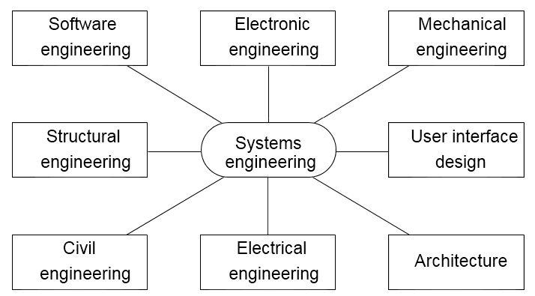
Systems engineering
Systems engineering is the activity of specifying, designing, implementing, validating, deploying and maintaining socio-technical systems.
Systems engineers are not just concerned with software but also with hardware and the system’s interactions with users and its environment.
Concerned with the services provided by the system, constraints on its construction and operation and the ways in which it is used.
Disciplines involved in systems engineering

Slide 9
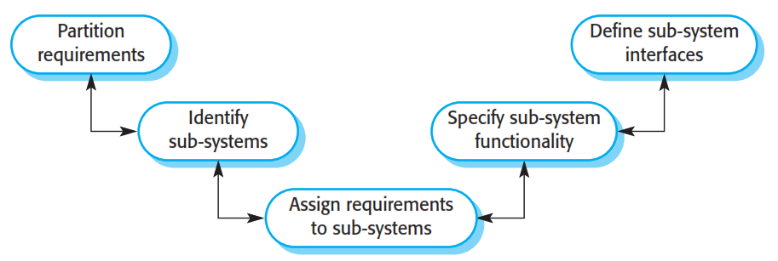
System design
The system design process

Slide 10
Legacy systems
Legacy systems are socio-technical computer-based systems that have been developed in the past, often using older or obsolete technology.
These systems include not only hardware and software but also legacy processes and procedures—old ways of doing things that are difficult to change because they rely on legacy software.
– Bank customer accounting system.

Slide 11
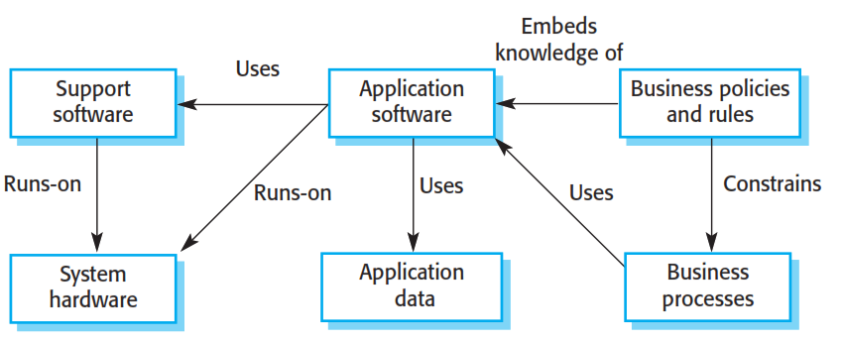
Legacy system components

Slide 12
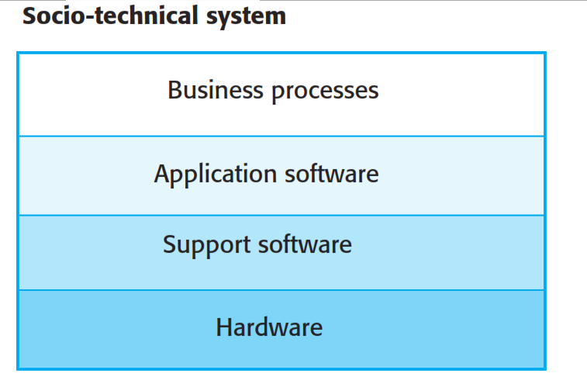
Layered model of legacy system

Slide 13
Critical System
Critical System
It is the systems that fail to deliver the expected objective in which any system failure can result in economic losses, physical damage or human life loss.
There are three main types of critical systems:
Safety-critical systems
Failure results in loss of life, damage to the environment;
Chemical plant protection system
Mission-critical systems
Failure results in failure of some goal-directed activity;
Spacecraft navigation system
Business-critical systems
Failure results in high economic losses;
Customer accounting system in a bank

Slide 14
System Dependability
The dependability of a computer system is a property of the system that reflects the user’s degree of trust in the system.
Principal dimensions of dependability are:
Availability
Reliability
Safety
Security

Slide 15
Dimensions of System Dependability

Slide 16
Other dependability properties
Repairability
Reflects the extent to which the system can be repaired in the event of a failure.
Maintainability
Reflects the extent to which the system can be adapted to new requirements.
Survivability
Reflects the extent to which the system can deliver services whilst under hostile attack.
Error tolerance
Reflects the extent to which user input errors can be avoided and tolerated.

Slide 17
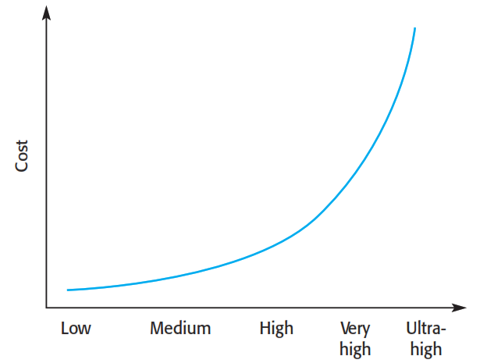
Dependability Costs Curve
Dependability costs tend to increase exponentially as increasing levels of dependability are required
There are two reasons for this
The use of more expensive development techniques and hardware that are required to achieve the higher levels of dependability
The increased testing and system validation that is required to convince the system client that the required levels of dependability have been achieved

Slide 18

Thanks to All

